Slide 1

SVKM’s Institute of Technology, Dhule Department of Information Technology
Major Project Presentation
On
“Virtual Try-on Platform”
By
Shantanu Bhadage 06
Yogesh Wani 56
Durgesh Gaikwad 15
Pratik Suryawanshi 51
Guide
“Prof.Sagar Badjate”
Day and Date of Review : Thursday, 17 August 2023

Slide 2
Project Details
Project Title : Virtual Try-on Platform
Project Domain: AR, CV, ML
Project Group Members:
T2054491246052 Shantanu Bhadage
T2054491246062 Yogesh Wani
T2054491246016 Durgesh Gaikwad
T2054491246042 Pratik Suryawanshi

Slide 3
Motivation
The motivation behind developing a virtual try-on platform is to help people to shop for clothes in a better way.
This platform provide user’s how clothes will fit &look on them without appearing.
This helps user’s feeling more sure about what they are buying and saves time and money by reducing returns. Plus, it's a fun way to explore different styles and show off fashion choices.
Overall, the goal is to make shopping more convenient, enjoyable, and reliable for everyone.

Slide 4
Problem statement
As more people shop for clothes online, they miss the ability to try on clothes before buying. Current virtual try-on solutions often don't accurately show how clothes will fit or look.
The challenge is to create a platform that lets users see themselves realistically in virtual clothes, considering factors like body shape, fabric, and movement.
This platform be easy to use, work with different brands, let users customize clothes, handle lots of users, and keep their data safe.
The goal is to create an online shopping experience that's as confident and satisfying as trying on clothes in a store.

Slide 5
Abstract
A virtual try-on platform is a technology that lets user’s "try on" clothes and accessories virtually.
Instead of physically putting them on, user can use a computer or smartphone to see how they would look on them through a screen.
It's like a digital dressing room that helps user decide what outfits suit them without actually wearing them.
This platform uses pictures or videos of the items and your own image, combining them to show how different clothes fit and match your style.
It's a fun and convenient way to explore fashion choices without the need to physically try everything on.

Slide 6
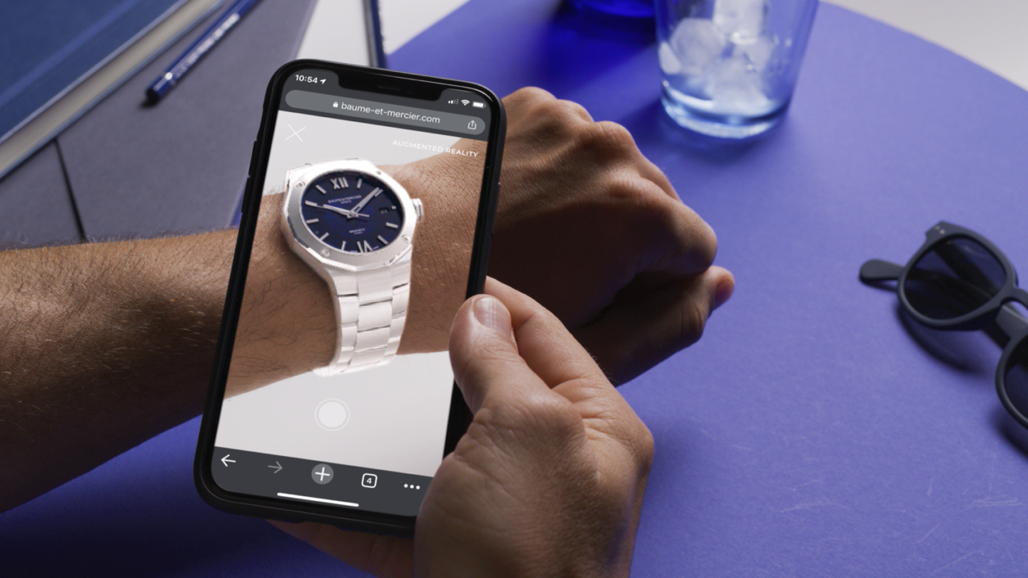
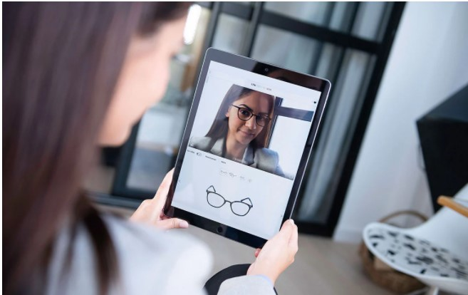
Existing System

Slide 7
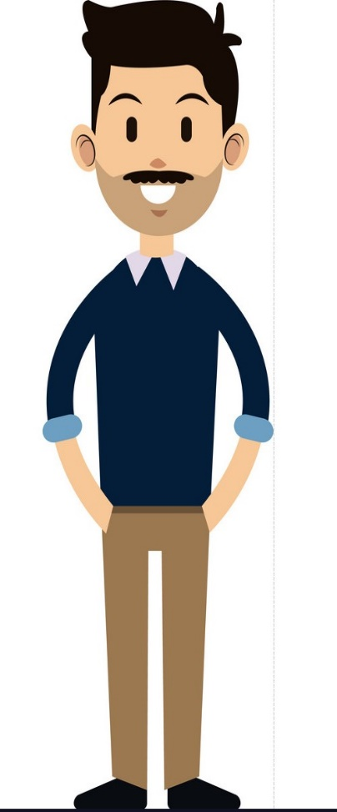
Architecture
Commands
Response
Smart Mirror
Clothes
Display
Share
Recommendations
Virtual Try-on
Live Input
Web Camera

Slide 8
Approach
Define the purpose
Choose Technology
Gather assets
Develop models
Image processing
User Interface
Development
Integration with E-Commerce

Slide 9
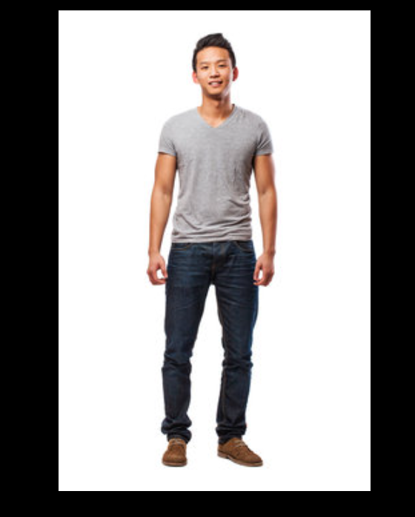
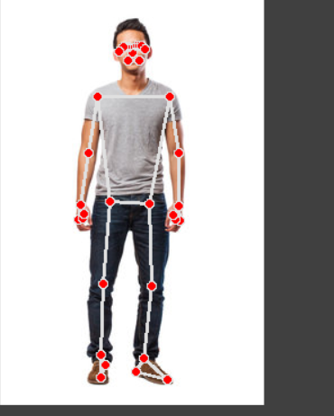
This image is get by scaling and managing the clothes which user try and according to this term lm11 = lmList[11][1:3]
lm12 = lmList[12][1:3]
it will extract the coordinates for positioning
After scaling & managing

Slide 10
Suggestions
Try to build page more attractive.
Don’t use any different methods instead of that use a single methods like opencv, or using the AR, VR.
Put some messages for the user by which they can interact with the system easily.

Slide 11
References
A. Sánchez-Ferrer, H. Pérez-Mendoza and P. Shiguihara-Juárez, "Data Visualization in Dashboards through Virtual Try-on Technology in Fashion Industry," 2019 IEEE Colombian Conference on Applications in Computational Intelligence (ColCACI), Barranquilla, Colombia, 2019, pp. 1-6, doi: 10.1109/ColCACI.2019.8781971.
B. Fele, A. Lampe, P. Peer and V. Štruc, "C-VTON: Context-Driven Image-Based Virtual Try-On Network," 2022 IEEE/CVF Winter Conference on Applications of Computer Vision (WACV), Waikoloa, HI, USA, 2022, pp. 2203-2212, doi: 10.1109/WACV51458.2022.00226.
T. Udiono and Maryani, "Perceptions of Using Augmented Reality Features on Online Shopping Fashion Platforms Based on Technology Acceptance Model," 2021 3rd International Conference on Cybernetics and Intelligent System (ICORIS), Makaras, Indonesia, 2021, pp. 1-5, doi: 10.1109/ICORIS52787.2021.9649444.
M. F. Hashmi, B. K. K. Ashish, A. G. Keskar, N. D. Bokde and Z. W. Geem, "FashionFit: Analysis of Mapping 3D Pose and Neural Body Fit for Custom Virtual Try-On," in IEEE Access, vol. 8, pp. 91603-91615, 2020, doi: 10.1109/ACCESS.2020.2993574.

